Slide 1
PSCS_83_Chatbot based helpdesk for govt employees and departments
CSE7101- Capstone Project
Review-1
Batch Number:CSE_68
Under the Supervision of,
Ms.Shet Reshma Prakash
Assistant Professor
School of Computer Science and Engineering
Presidency University
Roll Number | Student Name
20221CSE0052 20221CSE0060 20221CSE0006 | Safia Fathima Pritha Baidya Sonika A
Name of the Program: B.Tech(Computer science and Engineering)
Name of the HoD: Refer- Annexure-1
Name of the Program Project Coordinator: Refer- Annexure-1
Name of the School Project Coordinators: Dr. Sampath A K , Dr. Geetha A

Slide 2
Problem Statement Number: PSCS_83 Chatbot based helpdesk for govt employees and departments Software Smart Automation Govt. employees and departments need help in various process of general business
Problem Description:
Government employees regularly handle processes such as procurement, HR matters, financial approvals, IT support, and project implementation.
Currently:
Information is scattered across multiple portals and circulars.
Employees spend time searching for the right process or contacting multiple officers.
Coordination between departments is slow and inefficient.
Proposed Solution: A centralized, department-wise chatbot helpdesk to provide:
Quick access to rules, processes, and forms.
Automatic routing of queries to the correct department.
Ticket tracking for unresolved issues.
Benefits:
Increase productivity by reducing repetitive queries.
Improve inter-department communication.
Enhance employee satisfaction, indirectly benefiting citizens.

Slide 3
Objectives
Primary Objectives:
Deliver accurate, instant responses to employee queries.
Reduce time spent finding documents, forms, and rules.
Increase efficiency by automating department classification.
Secondary Objectives: 4. Maintain a digital ticketing and query tracking system. 5. Enable employees to interact in multiple languages, including regional languages. 6. Provide voice-enabled support for accessibility. 7. Offer an analytics dashboard to decision-makers for process improvement.

Slide 4
Background & Related Work
In many government offices, helpdesk systems are still manual or handled through phone/email.
Private sector chatbots (e.g., banking, telecom) have proven that automation reduces query resolution time.
A few government chatbots exist, but they focus on citizens (e.g., tax payment, public schemes) rather than internal staff.
This project fills the gap by focusing on internal government processes and building a knowledge repository for employees
.

Slide 5
Analysis of Problem Statement
Key Challenges Identified:
Repeated requests for the same information across departments.
Delays due to lack of centralized access to policies, forms, and procedures.
Misrouting of queries to the wrong department.
Lack of an easy-to-use platform for employees to seek help.
Impact of Not Addressing This:
Slower internal operations.
Lower productivity and job satisfaction.
Reduced efficiency in delivering citizen services.
Why Chatbot?
Available 24/7.
Easy to scale across departments.
Standardized answers to avoid confusion.

Slide 6
Github Link
The Github link provided should have public access permission.
Github Link
https://github.com/Saf-52/capstone-PSCS_83-Government-Employee-Helpdesk-Chatbot

Slide 7
Technology Stack
Software Requirements:
Frontend: Streamlit or Flask, HTML, CSS (for styling). Backend: Python (core chatbot logic), SQLite or Supabase for ticket storage. Machine Learning: TensorFlow/Keras, Scikit-learn for classification. Language Processing: NLTK/spaCy for text cleaning and keyword extraction. Translation: googletrans library for multi-language support. Voice Processing: SpeechRecognition for speech-to-text, pyttsx3 for text-to-speech. Hosting: Streamlit Cloud, Render, or Heroku (all free tiers). Analytics: Google Data Studio or Metabase for admin dashboards.

Slide 8
Software & Hardware Requirements
Software Requirements:
Python 3.x
Streamlit / Flask
TensorFlow / Keras
Scikit-learn
Pandas, NLTK/spaCy
SQLite / Supabase
SpeechRecognition
googletrans
GitHub for version control
Google Data Studio / Metabase for analytics
Hardware Requirements:
Desktop/Laptop with minimum 2GB RAM
Stable internet connection
Optional: Microphone for voice input feature testing

Slide 9
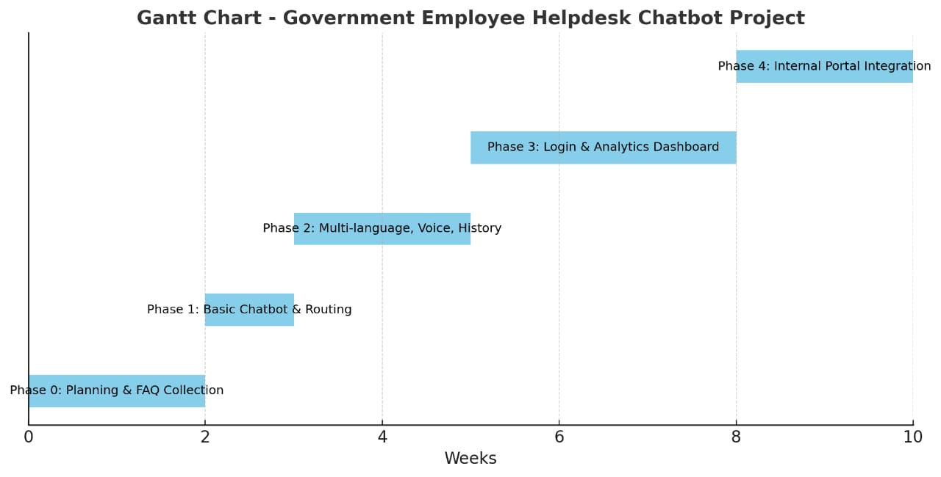
Timeline of the Project (Gantt Chart)

Slide 10
References (IEEE Paper format)
[1] A. Kumar, B. R. Patel, and C. Zhang, “Plant disease identification using convolutional neural networks,” IEEE Access, vol. 9, pp. 34567–34578, Mar. 2021. [2] J. Smith, “Deep learning in government systems,” IEEE Transactions on Neural Networks and Learning Systems, vol. 32, no. 7, pp. 1234–1245, Jul. 2021.

Slide 11


